Slide 1
Climate Change: An Introduction
Monday, November 10, 2014
-You need a sheet of paper.
-You do not need to write the questions.
-You do need to clearly write the heading for each section.
-You need to complete this assignment by the end of class.
-It will be taken up then.

Slide 2
The Earth is a complete, single system
Preview Questions (1 minute)
What does interconnected mean?
What does the atmosphere do?
What do the oceans do?
What does the land do?
What does plant life do?

Slide 3
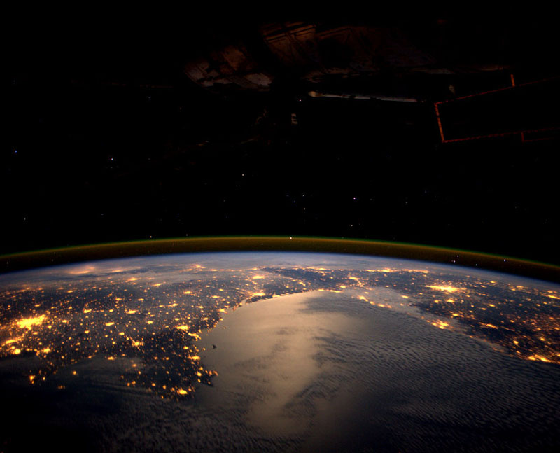
The Earth is a complete, single system
http://oeta.pbslearningmedia.org/resource/ess05.sci.ess.earthsys.hologlobe/earth-as-a-system/

Slide 4
The Earth is a complete, single system.
Answer Questions (7 minutes)
What does interconnected mean?
What does the atmosphere do?
What do the oceans do?
What does the land do?
What does plant life do?

Slide 5
We are able to track the changes in the earth .
Preview Questions (1 minute)
What is landsat?
When did it start?
What are two things landsat photographs have shown?

Slide 6
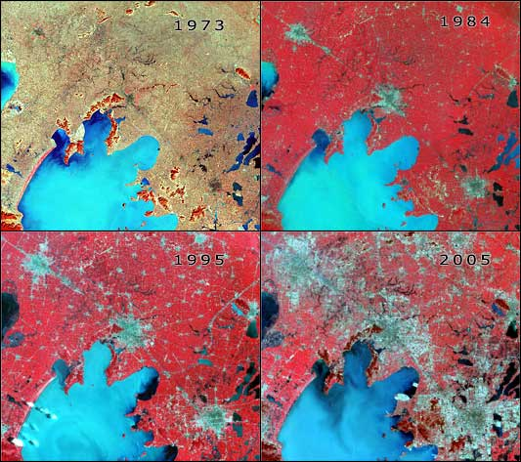
We are able to track the changes in the earth .
http://www.pbslearningmedia.org/resource/a4496c33-dfd2-4736-ba67-d2b283a1bd03/a-planetary-perspective-with-landsat-and-google-earth-engine/
Stop video at 2:37

Slide 7
We are able to track the changes in the earth.
Answer Questions (6 minute)
What is landsat?
When did it start?
What are two things landsat photographs have shown?

Slide 8
Climate Change: What is it? How does it work? What impact does it have?
Preview questions (1 minute)
An increase in carbon dioxide levels causes what to happen?
What caused the dramatic increase in carbon dioxide levels?
How much carbon dioxide do we produce per year?
What are two major contributors to the increase in carbon dioxide levels?
What does cataclysmic mean?
What are two things that are now noticeable that are caused by global warming?

Slide 9
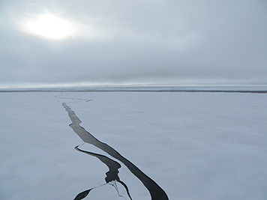
Climate Change: What is it? How does it work? What impact does it have?
http://www.smithsonianmag.com/videos/category/3play_1/climate-change-101-with-bill-nye-the-science/?no-ist

Slide 10
Climate Change: What is it? How does it work? What impact does it have?
Answer questions (Rest of class; due at end of hour)
An increase in carbon dioxide levels causes what to happen?
What caused the dramatic increase in carbon dioxide levels?
How much carbon dioxide do we produce per year?
What are two major contributors to the increase in carbon dioxide levels?
What does cataclysmic mean?
What are two things that are now noticeable that are caused by global warming?

