Slide 1
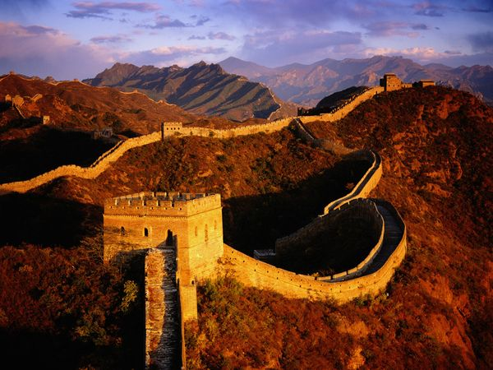
East/ Southeast Asia Super Ultimate Mega Unit!!!!!!

Slide 2
Physical Geography
--East Asia:
Asian Continent: China, Mongolia
Islands: Japan, Taiwan
Peninsula: North Korea, South Korea
--Southeast Asia
Indochina Peninsula: Vietnam, Laos, Cambodia, Thailand, Myanmar
Malay Peninsula: Malaysia, Singapore
Islands: Indonesia, Brunei, Philippines

Slide 3
Climate
Monsoons are important in both East Asia and Southeast Asia
Climates include Tropical Rain Forest, Humid Subtropical, Humid Continental, Marine West Coast, and Highland

Slide 4
Natural Resources
Renewable
Several major rivers including Hwang He (Yellow), Chiang Jiang (Yangtze), Xi, and Mekong
The Sea of Japan, South and East China Sea
Nonrenewable
Large deposits of minerals throughout the regions
Indonesia has a lot of oil

Slide 5
Population
-China has the highest population in the world
-Indonesia has the fourth largest population in the world
-Both regions are increasingly urbanized
-Urbanization means people live more and more in cities

Slide 6
History
Yeah, right

Slide 7
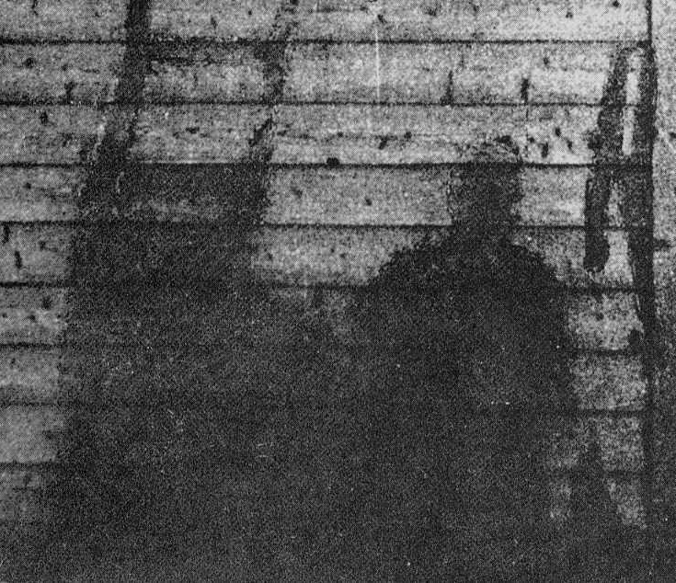
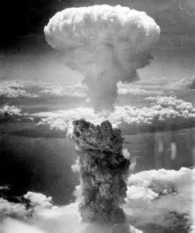
History
WW2 and Asia
US drops atomic bombs on Japan and wins war in Pacific
China becomes a Communist country in 1949
Taiwan becomes the home of the Chinese who did not want to be Communist
Korea is divided into North and South
Many colonies try to gain independence

Slide 8
Culture
Major Religion: Buddhism

Slide 9
Economy
Some of the countries are developed, like Japan, Singapore, and South Korea
Most of the countries are in the middle. They aren’t develoPED but they are not super poor, either.
This would include China, Vietnam, and Taiwan.
Some countries are develoPING: Cambodia, Laos, Mongolia.
Many countries benefit from outsourcing.

Slide 10
Environment
Major environment challenges:
Pollution
Population
Deforestation
Industrialization

Slide 11
Population Density

Slide 12
Three Gorges Dam
Built along the Yangtze/ Chang Jiang River
It was completed in 2012.
It cost thirty-seven billion dollars to build.
They used enough steel to build sixty Eiffel Towers.
It is the world’s largest power station
Over 100 towns were flooded on purpose.
1.3 million people had to be relocated by the government.

Slide 13
Three Gorgres Dam
A dam is a structure that controls the flow of a river.
People build dams for many reasons. Two big ones are irrigation and flood control.

Slide 14
Three Gorges Dam
There can be negative consequences. Dams can affect the life inside the river. They can erode the river bed. Dams also affect people who depend on water downstream from the river.

Slide 15
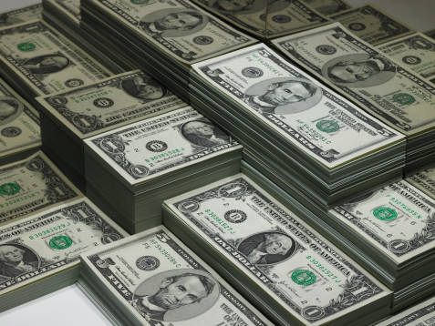
Outsourcing
You are part of a Board of Directors of a major American corporation that makes phones. Since you are a phenomenally successful businessperson, you are always looking for ways to keep more of your profits. Your biggest problem, as you see it right now, is the fact that the workers that you employ are required to receive a minimum wage and other payments like Social Security. You are also required to make sure working conditions are safe. Most workers expect to receive health insurance and retirement benefits. This makes every worker cost quit a bit of what you consider to be YOUR money. What can you do to increase your profits.?

