Slide 1
Laying the Foundation Notes
Settlement Patterns, Climate, Population Density, and a Brief History of Man

Slide 2
Population Density
Population Density- how crowded a place is
Dense: Crowded
Sparse: Not crowded.

Slide 3
Climate
Climate-The weather in a place over a long period of time.
The closer to the Equator, the hotter it is
The closer to water, the more stable the temperature is.
Mountains acts like combs that pulls moisture out of the air.
The higher a place is, the colder it is.

Slide 4
Climate
Low-Latitudes or Tropical
Falls in between 23.5 North and 23.5 South.
Midlatitudes
In between 23.5 and 66.5.
High Latitudes
Above 66.5

Slide 5
Climate

Slide 6
Climate
Precipitation—water a place receives
Vegetation—the type of plants a place has
Temperature—how hot or cold a place is

Slide 7
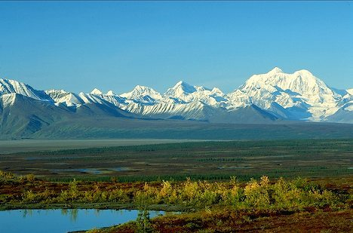
Climate

Slide 8
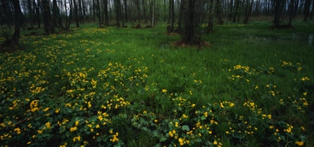
Climate

Slide 9
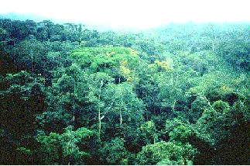
Climate

Slide 10
BHOH Timeline
Hunter-gatherer groups—Over 12,000 years ago (10,000 BC)
Agricultural Revolution/ Rise of Cultural Hearths (also known as Early Civilization)
—After 10,000 BC
Industrial Revolution—1700s AD
Information Revolution—1970s AD

Slide 11
BHOH Notes
Hunter-Gatherers
Major Goal-Food
Everybody was a HG before 10,000 BC
Hunted animals, gathered plants that already grew to eat.
Lived in small groups of people
Nomadic

Slide 12
BHOH Notes
Agricultural Revolution
When people learned how to farm
People settled in one place
Found places with lots of light, warmth, good soil
Often near rivers so they could use the water for irrigation
Once people figured out how to farm well, there SURPLUS food.

Slide 13
BHOH Notes
This caused
Different jobs (specialization or division of labor)
Towns
Towns are centers of trade
Bigger towns eventually become cultural hearths (ancient civilization)
Governments start
Writing systems start
Cultural Hearths
Are centers of culture
Causes cultural diffusion

Slide 14
BHOH Notes
Industrial Revolution
Happened in the 1700s
People began using machines to make stuff
They liked this because it made stuff
FASTER!
EASIER!
CHEAPER!
BETTER!

Slide 15
BHOH Notes
When people use machines to make stuff, that is called manufacturing
Manufacturing is usually done in factories
Factories are often called industries
When a society starts using a lot of manufacturing to make stuff, that is called industrialization.

Slide 16
BHOH Notes
The Industrial Revolution causes
People to quit being subsistence farmers
People to move to cities
People to have a lot more stuff
More and new inventions

Slide 17
BHOH Notes
The Information Revolution
The Industrial Revolution creates advanced machines and technology
This leads to the Information Revolution
Computers are invented in the 1940s; the Internet in the 1970s
Everyone’s life changes in the 1990s

